Slide 1
Azure Governance Challenge/Workshop
Presenter:

Slide 2
Agenda
Day#1
9 – 9:30 : Kickoff & Introductions
9:30 – 10:30 : Azure Governance Overview Presentation
10:30 - 10:45 : Break
10:45 – 11:30 : Management Groups and RBAC
11:30 – 12:30 : Azure Policy
Day#2
9 - 9:30 : Day#1 Learnings Overview
9:30 – 10:30 : Azure Blueprint
10:30 – 11:30 : Azure Cost Management + Resource Graph
11:00 – 12:00 : QnA

Slide 3
Agenda
Day#1
Kickoff & Introductions
Azure Governance Overview Presentation
Break
Management Groups
RBAC
Resource Locks
Azure Policy
Day#2
Day#1 Learnings Overview
Azure Blueprint
Azure Cost Management
Resource Graph
QnA

Slide 4
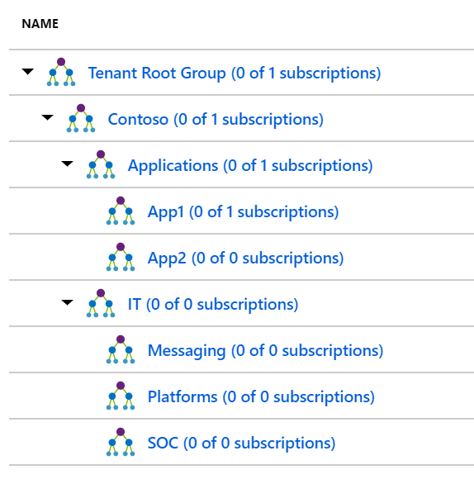
Management Groups Challenge
Draw a whiteboard of your suggested management group setup
Create a Management Group org structure that matches the sample on the slide
Move your subscription to App1 Management Group
Good luck!

Slide 5
RBAC Challenge
Create an AAD group and assign permissions at the Contoso management group level
Good luck!

Slide 6


Resource Lock Challenge
Create a resource lock on one of the VMs and test that it works.
Good luck!

Slide 7
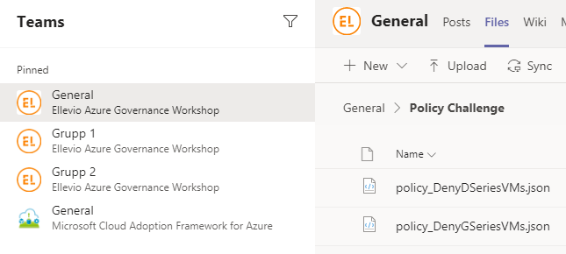
Azure Policy Challenge
Assign the Audit VMs that do not use managed disks policy at the Contoso Management Group Level
Create a custom policy that denies the users ability to deploy D series VM SKU at the Applications Management Group Level
The policy rules/conditions, in this case – VM SKU size equal to D series
The policy effect, in this case – Deny.
Note: json for policies can be found in the files tab in the general channel in Teams
Attempt to deploy a D series VM and find the deployment error in the Azure Activity Log
Good luck!
2
1
3
4

Slide 8
Azure Policy Challenge
Assign the Audit VMs that do not use managed disks policy at the Contoso Management Group Level
Create a custom policy that denies the users ability to deploy G series VM SKU at the Applications Management Group Level
The policy rules/conditions, in this case – VM SKU size equal to G series
The policy effect, in this case – Deny.
Note: json for policy can be found at the link below
Attempt to deploy a G series VM and find the deployment error in the Azure Activity Log
Good luck!
Resources:
http://aka.ms/mtcsto/ws

Slide 9
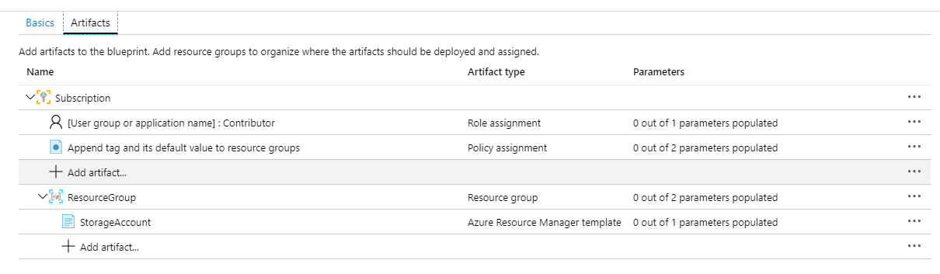
Azure Blueprint Challenge
Create a Blueprint in the Contoso Management Group that has the following:
Role assignment for Contributor
Policy Assignment for ‘Add or replace a tag on resource groups’
A Resource Group
Azure Resource Management Template for StorageAccount Note: json for template can be found in the files tab in the general channel in Teams
It should look like the screenshot
Add a description, publish and assign this Blueprint to the Free Trial Subscription. Use an existing group for role assignment Contributor. Set Tag Name to costCenter and Tag Value to ContosoIT.
Notes:
{ "$schema": "https://schema.management.azure.com/schemas/2015-01-01/deploymentTemplate.json#", "contentVersion": "1.0.0.0", "parameters": { "storageAccountType": { "type": "string", "defaultValue": "Standard_LRS", "allowedValues": [ "Standard_LRS", "Standard_GRS", "Standard_ZRS", "Premium_LRS" ], "metadata": { "description": "Storage Account type" } } }, "variables": { "storageAccountName": "[concat(uniquestring(resourceGroup().id), 'standardsa')]" }, "resources": [{ "type": "Microsoft.Storage/storageAccounts", "name": "[variables('storageAccountName')]", "apiVersion": "2016-01-01", "location": "[resourceGroup().location]", "sku": { "name": "[parameters('storageAccountType')]" }, "kind": "Storage", "properties": {} }], "outputs": { "storageAccountName": { "type": "string", "value": "[variables('storageAccountName')]" } } }

Slide 10
Azure Blueprint Challenge
Create a Blueprint in the Contoso Management Group that has the following:
Role assignment for Contributor
Policy Assignment for ‘Add or replace a tag on resource groups’
A Resource Group
Azure Resource Management Template for StorageAccount Note: json for template can be found at the link below
It should look like the screenshot on the next slide
Add a description, publish and assign this Blueprint to the Free Trial Subscription. Use an existing group for role assignment Contributor. Set Tag Name to costCenter and Tag Value to ContosoIT.
Resources:
http://aka.ms/mtcsto/ws
Notes:
{ "$schema": "https://schema.management.azure.com/schemas/2015-01-01/deploymentTemplate.json#", "contentVersion": "1.0.0.0", "parameters": { "storageAccountType": { "type": "string", "defaultValue": "Standard_LRS", "allowedValues": [ "Standard_LRS", "Standard_GRS", "Standard_ZRS", "Premium_LRS" ], "metadata": { "description": "Storage Account type" } } }, "variables": { "storageAccountName": "[concat(uniquestring(resourceGroup().id), 'standardsa')]" }, "resources": [{ "type": "Microsoft.Storage/storageAccounts", "name": "[variables('storageAccountName')]", "apiVersion": "2016-01-01", "location": "[resourceGroup().location]", "sku": { "name": "[parameters('storageAccountType')]" }, "kind": "Storage", "properties": {} }], "outputs": { "storageAccountName": { "type": "string", "value": "[variables('storageAccountName')]" } } }

Slide 11
Blueprint

Slide 12
Cost Management Challenge
Create a Monthly Cost report to determine which Resource type is costing the most
Create a monthly budget of $200 per month, set an alert when it reached 75% of budget, add an email address
Create an CSV export for the “Quarterly Cost by resource" for the Free Trial Subscription
Good luck

Slide 13
Resource Graph Challenge
Using Resource Graph Explorer
List out a summary count of resources
List out all resources and only show name, type and location. Sort by name in ascending order
List the distinct values of compute size in your Subscription
Good luck
Hints:
https://docs.microsoft.com/en-us/azure/governance/resource-graph/samples/starter

Slide 14
Azure Governance Practice Building
The key questions to ask end customers would be the ones that will have them thinking along the areas of security, compliance and cost
Are they complaint to the industry compliance requirements like PCI, ISO, SOC, CIS?
Are they having automated triggers in place to alert them when there are security breaches, cost overspend per department, per project?
Do they have guardrails to keep their Azure Environments according to the agreed upon specifications like every resource has department tags, developers can use only certain VM SKUs, only encrypted disk allowed?
Have they optimized their Azure environments for cost? Example: Are they over provisioning, are there policies in place to shutdown dev VMs during night hours?
How quickly can they create new environments per their specifications and needs? Is it a one click deployment for new environments?
Do they have ways where they can grant Role based access?

